Slide 1



Slide 2
GROUP MEMBERS
Name -Tangudu Prabhas
Roll no - 21cse639
Name - Madi Jaggadish
Roll no - 21cse271
Name - Chilla Dilip Kumar
Roll no - 21cse535

Slide 3
OUTLINE
INTRODUCTION
OBJECTIVES
FEATURES
REQUIREMENTS
MODEL VIEW
EXPECTED OUTPUT

Slide 4
INTRODUCTION
Navigating Sales Heights is specifically designed for Adventurous Works Company .By harnessing the capabilities of Power BI , a powerful business analytics tool , the report aims to provide valuable insights into the sales performance of Adventurous Works Company and facilitate data-driven decision-making.

Slide 5
OBJECTIVES
Reduce Sales Expenses
Better Sales Planning
Achieve Long Term Growth
Create unique position in markets
Increasing Profit

Slide 6
FEATURES
Dynamic Dashboard
Comparative Analysis
Sales Trend over Years and Fiscal Year
Drill-Down Capabilities
Tool Tips

Slide 7
REQUIREMENTS
HARDWARE REQUIREMENTS
SOFTWARE REQUIREMENTS
➢ Intel core i5 12nd generation is used as a processor .
POWER BI
SQL SERVER MANAGEMENT
➢ Ram 1 gb is used as it will provide fast reading and writing capabilities.

Slide 8
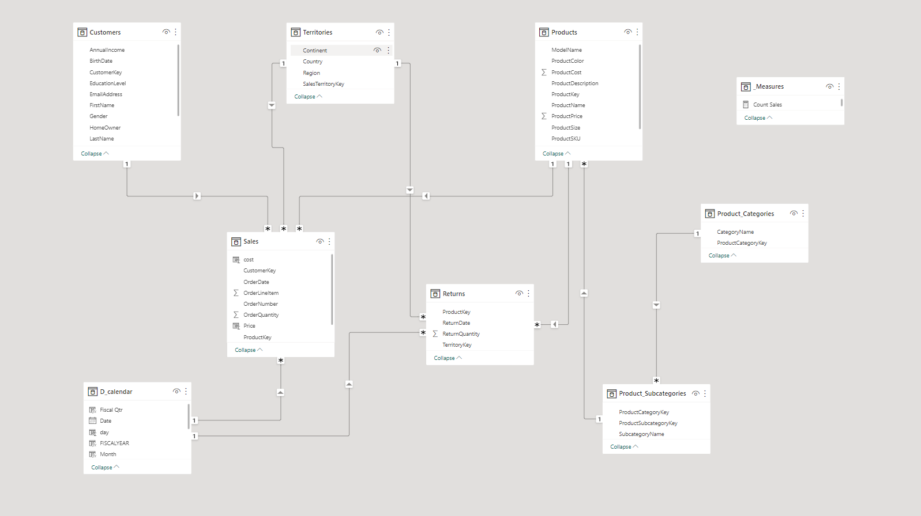
MODEL VIEW

Slide 9
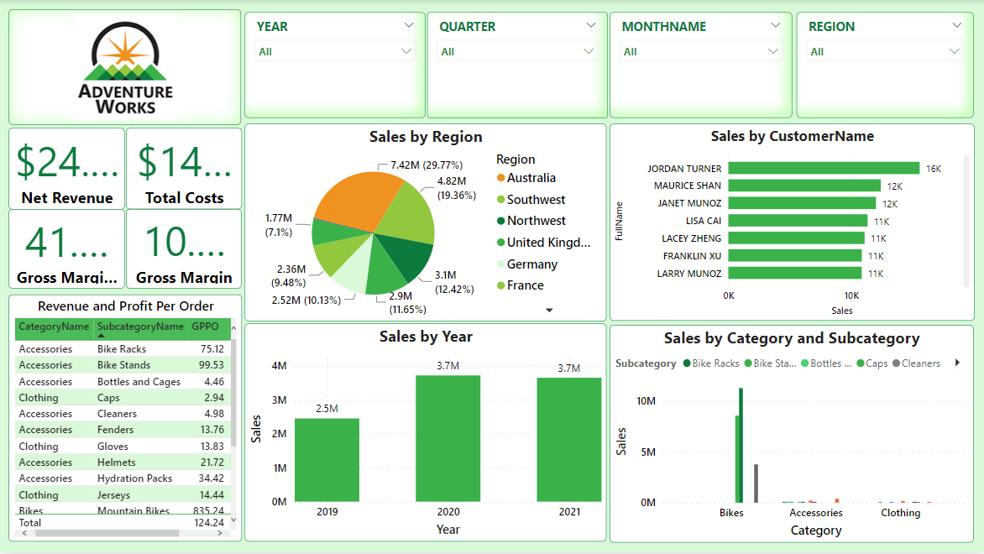
EXPECTED OUTPUT

Slide 10
THANK YOU

